Slide 1

Concordia: Distributed Shared Memory with In-Network Cache Coherence
汇报人：夏武

Slide 2
Distributed Shared Memory (DSM)
Classic DSM (early 1990s )
Unified memory space
Ease programming for distributed apps
Failed due to unsatisfying performance
Applications
Unified Memory Address
Memory
Memory
Memory

Slide 3
Distributed Shared Memory (DSM)
Classic DSM (early 1990s )
Unified memory space
Ease programming for distributed apps
Failed due to unsatisfying performance
Modern DSM (2010 - now)
Sparked by fast network (e.g., RDMA)
Support modern apps (e.g., OLTP, Graph)
Example: Microsoft’s FaRM
Applications
Cache
Cache
Unifi
ed Memory Address
Memory
Memory
Memory

Slide 4


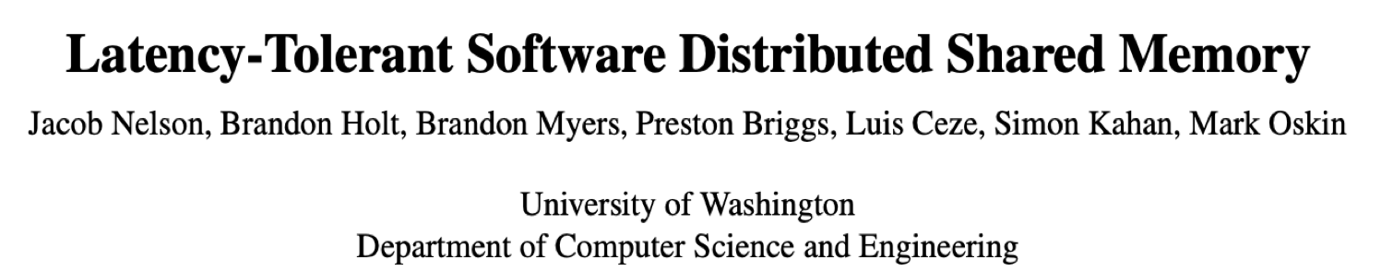


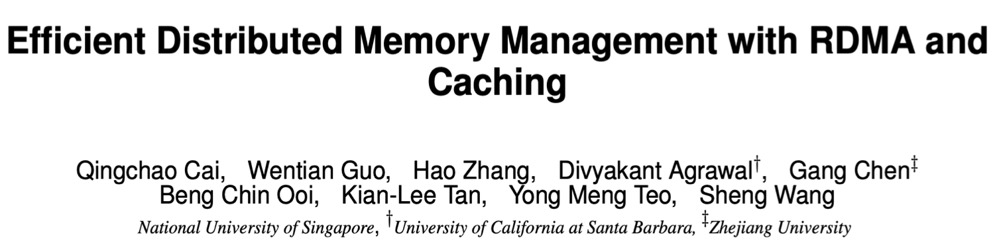


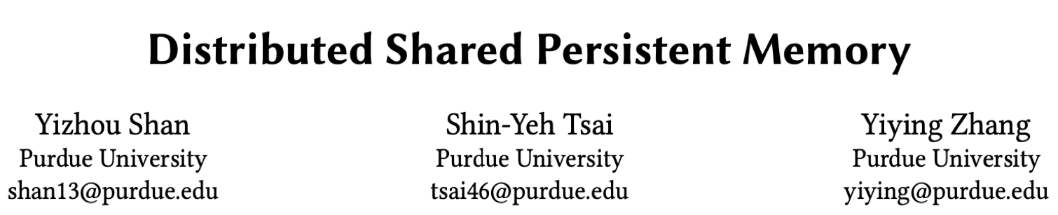


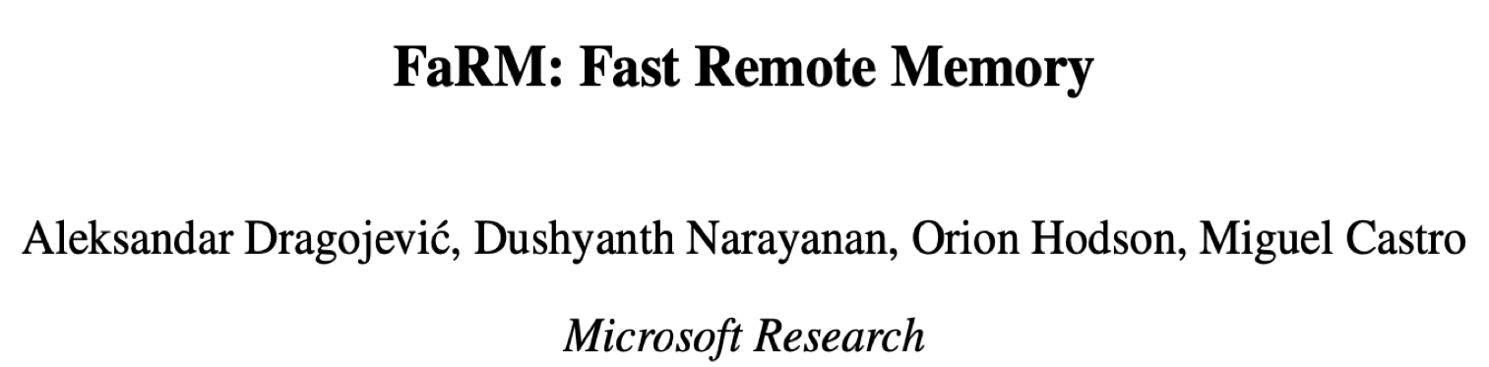
Distributed Shared Memory (DSM)
Classic DSM (early 1990s )
Unified memory space
Ease programming for distributed apps
Failed due to unsatisfying performance
Modern DSM (2010 - now)
Sparked by fast network (e.g., RDMA)
Support modern apps (e.g., OLTP, Graph)
Example: Microsoft’s FaRM
Applications
Cache
Cache
Unifi
ed Memory Address
Memory
Memory
Memory

Slide 5
Caching & Coherence
caching is a must
Boost performance
Bandwidth: local mem vs. network → 2-4X
Latency: local mem vs. network → 12X
Coherence is necessary
Offer strong consistency
✕ But, need slow distributed coordination
Applications
Cache
Cache
Unifi
ed Memory Address
Memory
Memory
Memory

Slide 6
Caching & Coherence
caching is a must
Boost performance
Bandwidth: local mem vs. network → 2-4X
Latency: local mem vs. network → 12X
Coherence is necessary
Offer strong consistency
✕ But, need slow distributed coordination
Applications
Cache
Cache
Unifi
ed Memory Address
Memory
Memory
Memory
1. write
1. write
$
$
2. to home
3. invalidate
2. broadcast
Home
$
$
$
$
基于目录
基于监听

Slide 7

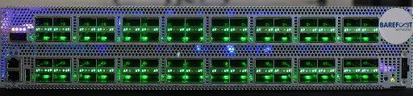
Opportunities from Programmable Switches
Ingress Pipeline
Stage 1
Egress Pipeline
Stage 2
Stage n
Parser
Arrays
Arrays
…
Arrays
❷
…
Deparser
Tables
Tables
Tables
❶
PHV
pkt
Match-Action Table
ttl_arr
Register Array
97
5
27
…
0
1
2
user-defined line-rate network protocols
type : 0x11 ttl : 0x24
Match | pkt.type == 0x11
Action | pkt.ttl = pkt.ttl-1
Match | pkt.type == 0x11
Action | ttl_arr[pkt.ttl]++
由于交换机是服务器间通信的中心枢纽，因此将其重新配置以处理缓存一致性可以显著减少服务器之间的协调。
最新的交换机每秒可以处理数十亿个数据包，使它们能够快速处理一致性请求。
交换机拥有一个片上内存，允许在交换机中存储缓存块元数据。此外，片上存储器可以支持原子读修改写操作，从而简化同步冲突一致性请求的工作。

Slide 8
Challenges
1、 有限的计算能力
相比于server节点，交换机能够处理的逻辑比较简单，然而缓存一致性维护包括状态机转化等问题，其逻辑比较复杂，需要考虑交换机与server节点之间的任务分配

Slide 9
Challenges
1、 有限的计算能力
相比于server节点，交换机能够处理的逻辑比较简单，然而缓存一致性维护包括状态机转化等问题，其逻辑比较复杂，需要考虑交换机与server节点之间的任务分配
2、 有限的存储能力
交换机的存储能力有限(约几MB)，还需要保留一些内存来服务正常的网络协议。所以面对TB量级的数据，需要考虑如何有效管理的问题

Slide 10
Challenges
1、 有限的计算能力
相比于server节点，交换机能够处理的逻辑比较简单，然而缓存一致性维护包括状态机转化等问题，其逻辑比较复杂，需要考虑交换机与server节点之间的任务分配
2、 有限的存储能力
交换机的存储能力有限(约几MB)，还需要保留一些内存来服务正常的网络协议。所以面对TB量级的数据，需要考虑如何有效管理的问题
3、 有状态性质
由于交换机内部存有读写锁，也就是说交换机是一个有状态的网络设备，网络超时重传可能会导致系统逻辑混乱

Slide 11
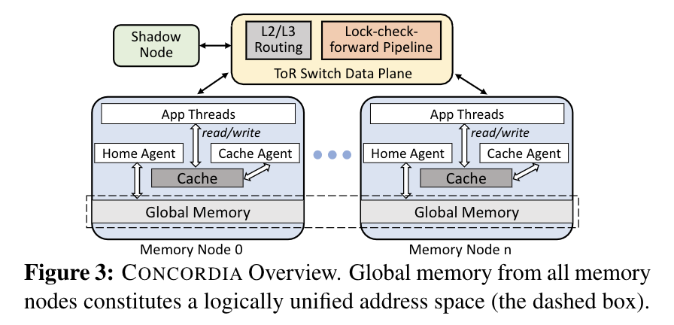
Concordia Architecture
Memory nodes (servers)
Global memory
Local cache
Linearizable write/read interface
switch
Route normal packets
Accelerate coherence
Shadow nodes
Record coherence traffic

Slide 12
Key Designs
1、针对计算能力有限
Concordia将一次完整的cache一致性协议维护流程分担给server与交换机共同完成，其中逻辑比较简单、但是在关键路径上的部分交给交换机，如持锁以及无效数据的多播，而逻辑比较复杂，但是可以异步完成(即不在关键路径上)的部分交给server，如一次无效化完成之后数据状态的转化，就可以由server异步的发给交换机，以更新其状态

Slide 13
Key Designs
1、针对计算能力有限
Concordia将一次完整的cache一致性协议维护流程分担给server与交换机共同完成，其中逻辑比较简单、但是在关键路径上的部分交给交换机，如持锁以及无效数据的多播，而逻辑比较复杂，但是可以异步完成(即不在关键路径上)的部分交给server，如一次无效化完成之后数据状态的转化，就可以由server异步的发给交换机，以更新其状态
2、针对存储能力有限
只存储少数热点数据的目录在交换机中，并向上提供迁移数据目录的接口。数据的热度可能会随时间变化而变化，因此Concordia会令交换机与server按时间片追踪数据的热度信息，并汇总给与交换机连接的shadow node，来决定下一个时间片内哪些数据应当换入交换机，哪些数据应当换出

Slide 14
Key Designs
1、针对计算能力有限
Concordia将一次完整的cache一致性协议维护流程分担给server与交换机共同完成，其中逻辑比较简单、但是在关键路径上的部分交给交换机，如持锁以及无效数据的多播，而逻辑比较复杂，但是可以异步完成(即不在关键路径上)的部分交给server，如一次无效化完成之后数据状态的转化，就可以由server异步的发给交换机，以更新其状态
2、针对存储能力有限
只存储少数热点数据的目录在交换机中，并向上提供迁移数据目录的接口。数据的热度可能会随时间变化而变化，因此Concordia会令交换机与server按时间片追踪数据的热度信息，并汇总给与交换机连接的shadow node，来决定下一个时间片内哪些数据应当换入交换机，哪些数据应当换出
3、针对交换机的有状态性
如果网络因为超时而产生重传，但是最终却有两个数据包都抵达了目的地(交换机、server)，就可能会引起逻辑错误，比如对交换机来说可能会多次放锁引起死锁。之所以会出现这个现象，是由于交换机工作的网络层上并没有机制过滤掉重复发送的数据包。解决方法也非常简单，即自己加入一个去重逻辑，通过对消息编号，实现能够去重的幂等操作。

Slide 15
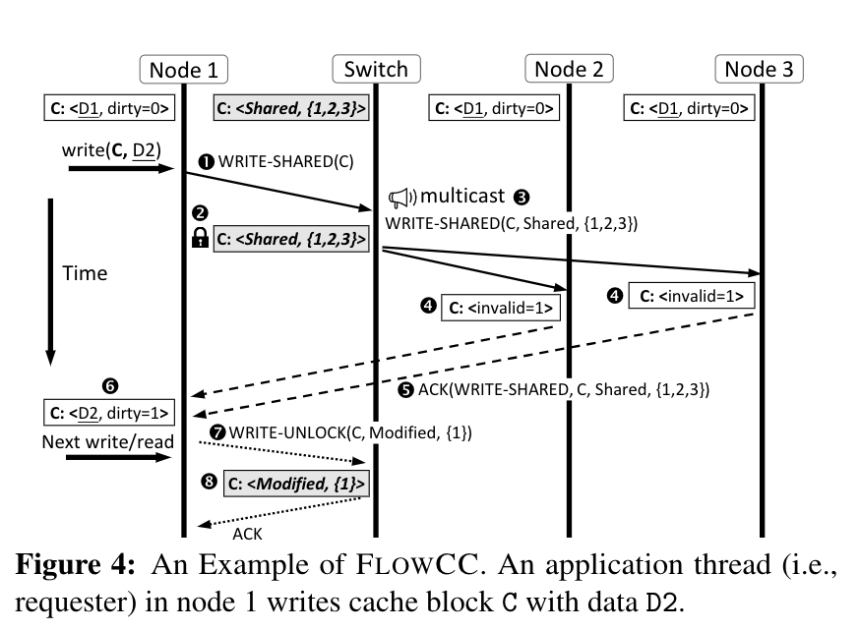
FLOWCC Protocol
写失效协议FLOWCC，它在交换机和服务器之间划分一致性责任。交换机序列化冲突请求，并通过锁定前向检查（LCF）管道将它们多播到正确的主/缓存代理。服务器执行状态转换并更新交换机数据平面。

Slide 16
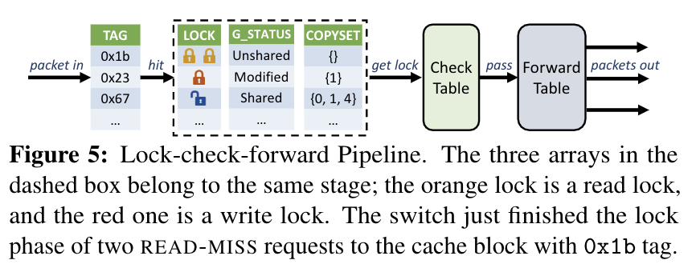
LCF Pipeline
锁定请求的缓存块以进行并发控制。
检查请求的有效性。
将请求转发至最终目的地。

Slide 17


Ownership Migration
Limited switch memory cannot accommodate metadata of all cache blocks
The switch manages coherence of active cache blocks
Ownership Migration
If a cache block triggers lots of invalidations, migrate its ownership: Servers → Switch
If a cache block is inactive,
migrate its ownership: Switch → Servers
active
In Server
In Switch
inactive
* For a cache block, its ownership refers to the right to manage its coherence.

Slide 18
Idempotent Operations
Packet loss due to switch buffer overflow
Make all operations both in servers and switches idempotent
On suspecting a lost request via timeout, the app thread retransmits it …
Server Idempotence
Requests contain unique SNs (sequence number)
Switch Idempotence
For each app thread, the switch records
Servers record SNs of executed requests，
whether it holds lock, to avoid deadlock and
to filter out duplicated requests
repeated unlock

Slide 19
More details:
Design details
Switch data plane design
Cases of different requests (e.g., cache eviction)
Handling failures of different components
Correctness proof
Corner cases of ownership migration
Implementation details
Network stack (RDMA)
Cache organization (set-associative)
Global memory allocation (two-level allocation)
Synchronization primitive (rwlock)

Slide 20
Experimental Setup
Hardware Platform
Server * 8
Programmable Switch * 1
CPU | 2 Intel Xeon E5-2650 CPUs
NIC | 100Gbps Mellanox ConnectX-5
OS | CentOS 7.4 , Linux kernel 3.10.0
Type | Barefoot Tofino switch
Port | 32 * 100Gbps
SW | bf-sde-8.2.0
Compared DSMs
Grappa [ATC’15] | No caching, ship computation, RDMA-based
GAM [VLDB’18] | Caching, directory-based coherence, RDMA-based
Concordia-base | Servers manage coherence of all cache blocks
Benchmark
Micro benchmarks (sharing ratio, locality ratio, reading ratio…)
Applications (key-value store, transaction, graph computation)

Slide 21
Micro Benchmarks
Total Throughput [Mop/s]
14
12
10
8
6
4
2
Grappa
GAM
Concordia-base
Concordia
0
0
20
40 60
Sharing Ratio (%)
80 100
(A) Throughput
4 app threads per node,
8-bytes writes/reads (1:1), No locality
8GB working set, 1GB cache, 250MB shared areas

Slide 22
Micro Benchmarks
Total Throughput [Mop/s]
14
12
10
8
6
4
2
Grappa
GAM
Concordia-base
Concordia
4.4×
0
0
20
40 60
Sharing Ratio (%)
80 100
(A) Throughput
4 app threads per node,
8-bytes writes/reads (1:1), No locality
8GB working set, 1GB cache, 250MB shared areas

Slide 23
Micro Benchmarks
Total Throughput [Mop/s]
14
12
10
8
6
4
2
Grappa
GAM
Concordia-base
Concordia
1.5×
0
0
20
40 60
Sharing Ratio (%)
80 100
(A) Throughput
4 app threads per node,
8-bytes writes/reads (1:1), No locality
8GB working set, 1GB cache, 250MB shared areas

Slide 24
Micro Benchmarks
Total Throughput [Mop/s]
14
12
10
8
6
4
2
Grappa
Concordia-base
Concordia
GAM
Concordia-base
# of Packets (million)
150
(a) Recive
(b) Send
Concordia
100
50
0
0 20
0
40 60 80 100
Sharing Ratio (%)
0 100 0 100
Sharing Ratio (%)
(A) Throughput
4 app threads per node,
8-bytes writes/reads (1:1), No locality
8GB working set, 1GB cache, 250MB shared areas
(B) Packets received/sent by servers
Concordia effectively reduces network traffic

Slide 25



Applications
Zipfan 0.99
8-byte key, 128-byte value
Hash table index
Grappa GAM Concordia
Ported from GAM
Share everything
32 warehouses
GAM Concordia
Vertex-centric
Gather, apply and scatter
Two dataset
Concordia Grappa PowerGraph
Total Throughput [Mop/s]
3 1.5
50% GET
Throughput
Abort Rate
95% GET
Throughput [K tps]
LiveJournal
Twitter
200 0.4
Run Time (second)
40
400
Abort Rate
2
100
1
0.5
20
200
0
0
0
0
2 4 6 8
2 4 6 8
# of Node
0 100 0 100
0 0
4 Nodes 8 Nodes 4 Nodes 8 Nodes
(C) Graph Comp (PageRank)
# of Node
Distribution Ratio (%)
(A) Key-value Store (YCSB-like) (B) Transaction (TPCC)
Concordia supports various applications, and boosts their performance

Slide 26
Summary & Conclusion
Problem
Cache coherence is slow in modern DSM
Key Idea
Using programmable switches, with switch-server co-design
Techniques in Concordia
In-network coherence protocol
Ownership migration
Idempotent operations
Results
Concordia outperforms state-of-the-arts
Concordia underpins various applications

Slide 27
THANKS！

